Slide 1
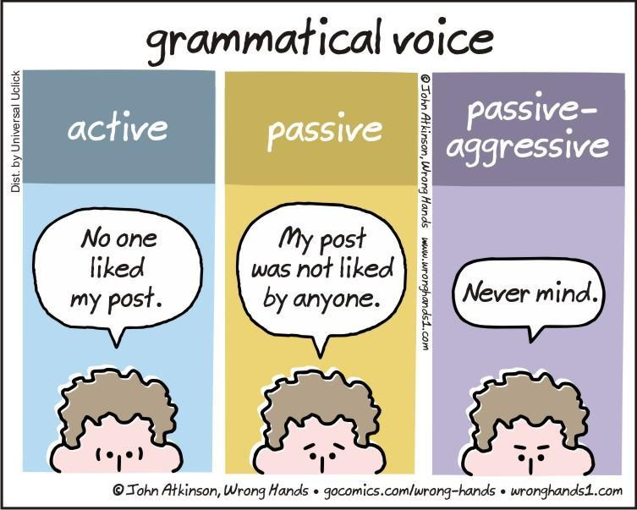
Grammar & Basica
The Passive

Slide 2
How to make an active sentence passive
Make the object of the active sentence the subject of the passive sentence
Use a form of (to) be in the same tense and use the past participle (of the verb in the active sentence)
If relevant, the subject of the active sentence can be put at the end in an adverbial (by-phrase)

Slide 3
How to make an active sentence passive
John | opens | the door
subject | verb | object
The door | is opened | (by John)
subject | verb | object

Slide 4
The Passive
We saw an example of the past simple tense
(America was discovered by Columbus)
and
of the present simple tense
(the door is opened)
The passive can be used in nearly all of the tenses

Slide 5
Tenses and the passive
Form | Active | Passive
Present simple | They clean the house
Present continuous | They are cleaning the house
Present perfect | They have cleaned the house
Past simple | They cleaned the house
Past continuous | They were cleaning the house
Past perfect | They had cleaned the house
Future | They will* clean the house
* Same for all modal verbs

Slide 6
Tenses and the passive
Form | Active | Passive
Present simple | They clean the house | The house is cleaned (by them)
Present continuous | They are cleaning the house | The is being cleaned (by them)
Present perfect | They have cleaned the house | The house has been cleaned (by them)
Past simple | They cleaned the house | The house was cleaned (by them)
Past continuous | They were cleaning the house | The house was being cleaned (by them)
Past perfect | They had cleaned the house | The house had been cleaned (by them)
Future | They will* clean the house | The house will be cleaned
* Same for all modal verbs

Slide 7
Verbs that take two objects
Verb | Active | Passive
give | The nurse gives the patient a sleeping pill.
allow, ask, feed, send
 | The man fed the horse a bale of hay.

Slide 8
Verbs that take two objects
Verb | Active | Passive
give | The nurse gives the patient a sleeping pill. | A sleeping pill is given to the patient.
 |  | The patient is given a sleeping pill.
allow, ask, feed, send
 | The man fed the horse a bale of hay. | A bale of hay was fed to the horse.
 |  | The horse was fed a bale of hay.

Slide 9
Exceptions (I)
Verb | Active | Passive
Verbs without object
happen | Something happened | x
stay | We stayed at home
Some state verbs
lack | The player lacks talent | x
have | We have three dogs | x

Slide 10
Exceptions (II)
Verb | Active | Passive
Verbs that are action and state verbs. Only passive when they are action verbs (cost, fit, measure, weigh)
As a state verb
weigh | The person weighed 80 kilos | -
As an action verb
weigh | The woman weighed the apples on the scale | The apples were weighed on the scale (by the woman)

Slide 11
Translating
Watch out when translating Dutch “er”:
Er zijn veel mensen ontslagen.
*There have been many people fired.
Many people have been fired.

Slide 12
Exercise Change the active sentences to passive
1. The board supports the latest initiative.
____________________________________________________________________________
2. We have informed him.
____________________________________________________________________________
3. We will offer him many different options. (2 answers!)
____________________________________________________________________________
____________________________________________________________________________
4. Jane brought up the issue at last night’s meeting.
____________________________________________________________________________

Slide 13
Answer key: pay attention to the verb tense!
1. The board supports the latest initiative.
The lastest initiative is supported by the board.
2. We have informed him.
He has been informed. / He has been informed by us.
3. We will offer him many different options. (2 answers!)
Many different options will be offered to him.
He will be offered many different options.
4. Jane brought up the issue at last night’s meeting.
The issue was brought up at last night’s meeting by Jane.

Slide 14
5. The police are investigating the matter.
____________________________________________________________________________
6. They have cleaned the room.
____________________________________________________________________________
7. The people gave the candidate an ultimatum. (2 answers!)
____________________________________________________________________________
____________________________________________________________________________
8. This measure could save the company.
____________________________________________________________________________

Slide 15
Answer key: pay attention to the verb tense!
5. The police are investigating the matter.
The matter is being investigated by the police.
6. They have cleaned the room.
The room has been cleaned.
7. The people gave the candidate an ultimatum. (2 answers!)
The candidate was given an ultimatum.
An ultimatum was given to the candidate.
8. This measure could save the company.
The company could be saved by this measure.

